Slide 1
SESSION 1
Goal: build intuition for predicting categories and choosing metrics based on the cost of errors.
Classification Fundamentals
Logistic regression • Decision trees • Confusion matrices • Precision • Recall • F1-score
Session focus
• Classification problem framing
• Probabilities and thresholds
• Logistic regression and trees
• Confusion matrices
• Precision, recall, and F1
Applied AI Design Workshop for Faculty
Fred Livingston (fjliving@ncsu.edu) 2026
1

Slide 2
APPLIED AI DESIGN WORKSHOP
DAY 4
Day 3 recap: foundations established
Session 1
Translated engineering and disciplinary problems into ML tasks; defined inputs, targets, units, baselines, and success criteria.
Session 2
Compared regression, classification, clustering, dimensionality reduction, forecasting, and anomaly detection.
Session 3
Introduced regression fundamentals, model baselines, residuals, and evaluation using MAE, RMSE, and R².
Technical skills practiced
Loaded data with pandas, identified X and y, inspected DataFrames, visualized relationships, and used a basic scikit-learn regression workflow.
Day 4 transition
Move from continuous prediction to categorical prediction, then complete an end-to-end baseline workflow before data preparation and unsupervised discovery.
Opening prompt: Which Day 3 decision most affects whether a model is useful—problem framing, baseline selection, or metric choice?

Slide 3

APPLIED AI DESIGN WORKSHOP
DAY 4
Day 3 recap: Technical Skills
https://pandas.pydata.org
pandas is short for "PANel DAta S"
Pandas Paper: McKinney, Wes. "Data structures for statistical computing in python." Proceedings of the 9th Python in Science Conference. Vol. 445.
2010.

Slide 4
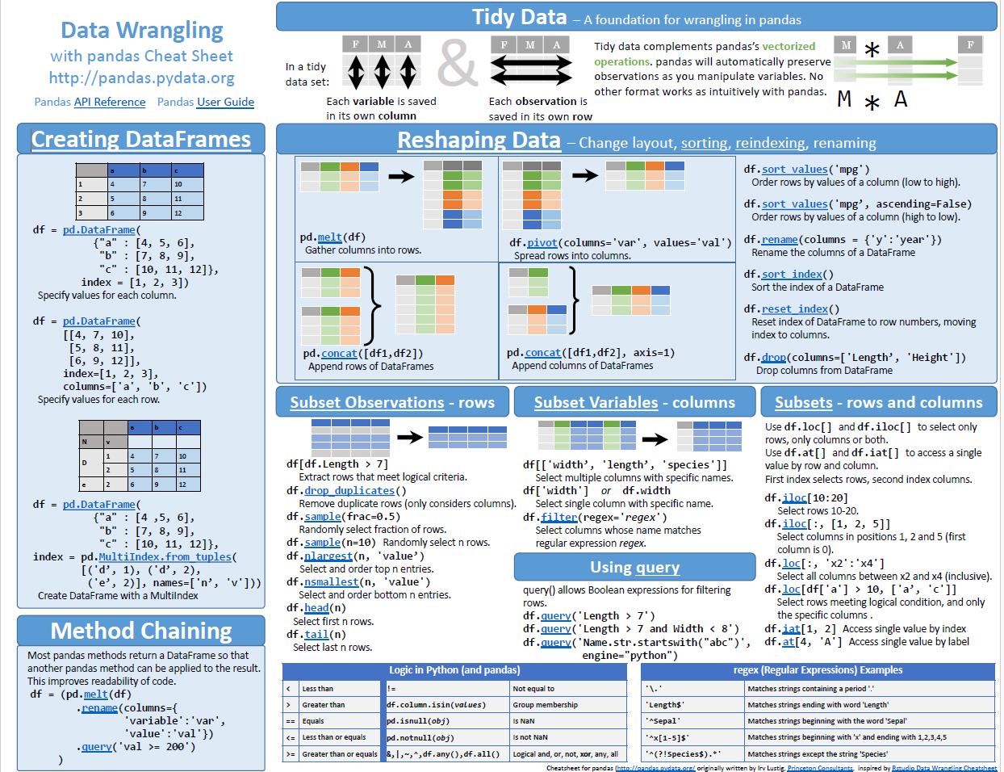
APPLIED AI DESIGN WORKSHOP
DAY 4
Day 3 recap: Technical Skills

Slide 5
APPLIED AI DESIGN WORKSHOP
DAY 4
Day 3 recap: Technical Skills

Slide 6
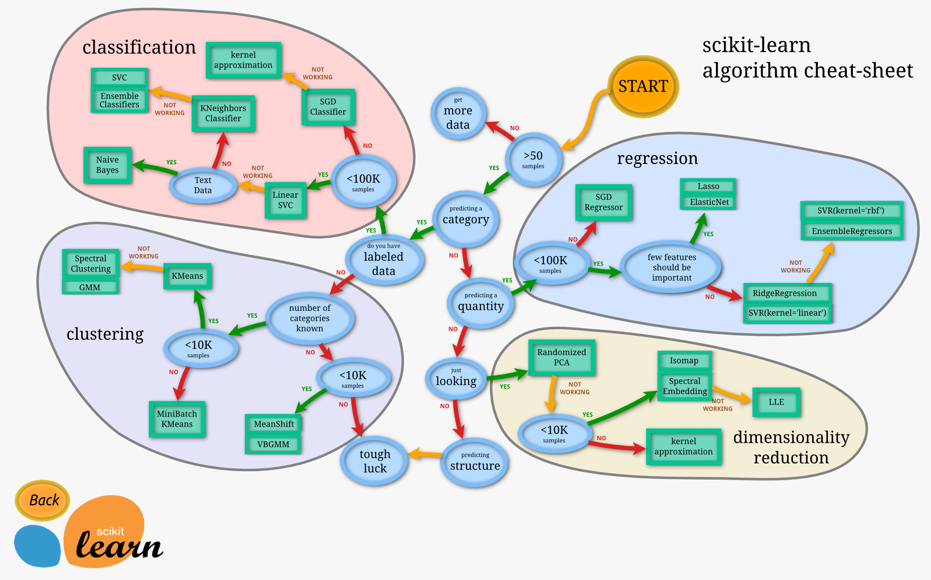
APPLIED AI DESIGN WORKSHOP
DAY 4
Day 3 recap: Technical Skills

Slide 7
APPLIED AI DESIGN WORKSHOP
DAY 4
Day 4 objectives and learning outcomes
Objective: extend the applied ML workflow from regression to classification, baseline modeling, data preparation, and unsupervised learning.
Classify
Apply logistic regression and decision trees to categorical outcomes.
Prepare
Identify missing values, outliers, data-type problems, categorical variables, and leakage risks.
Evaluate
Interpret probabilities, confusion matrices, accuracy, precision, recall, and F1-score.
Engineer
Apply scaling, encoding, feature selection, and domain-informed feature development.
Compare
Evaluate candidate models against a simple majority-class or mean baseline.
Discover
Distinguish supervised from unsupervised learning and explain k-means, hierarchical clustering, and DBSCAN.
Build
Complete a basic regression or classification workflow from preparation through initial evaluation.
Interpret
Use disciplinary knowledge and validation evidence to judge whether clusters are meaningful.

Slide 8
APPLIED AI DESIGN WORKSHOP
Day 4 schedule
Day 4 schedule
Session 1 — Classification Fundamentals
Session 2 — Hands-On Baseline ML Model
Break
Invited Presentation — LLM and AI Workflows on NCSU’s Hazel HPC
Session 3 — Data Preparation and Feature Engineering
Special Topic Session
Session 4 — Unsupervised Learning for Discovery

Slide 9
APPLIED AI DESIGN WORKSHOP
Session 1
Session 1 learning outcomes
Frame
Recognize when a categorical target makes classification appropriate
Explain
Describe logistic regression, decision trees, and predicted probabilities
Evaluate
Interpret confusion matrices and common classification metrics
Choose
Select metrics based on consequences of false positives and false negatives
Prepare
Connect classification concepts to the baseline model activity
Participant output: a classification problem statement, a baseline choice, an initial metric, and one discussion of error consequences.
3

Slide 10
APPLIED AI DESIGN WORKSHOP
Session 1
What makes a problem a classification problem?
Classification predicts a category or class label. The model is judged by whether the predicted class is correct and which errors matter most.
Use classification when asking:
• Which category?
• Pass or fail?
• Normal or faulty?
• Eligible or not?
• Which condition?
Typical targets:
• Defective / acceptable
• Fault / no fault
• Risk level
• Material type
• Operating mode
• Course outcome
Not classification when:
• Target is continuous
• Goal is discovering unknown groups
• No labeled examples exist
• The output is a ranking only
Key discipline question: Which error is more costly — a false alarm or a missed case?
4

Slide 11
APPLIED AI DESIGN WORKSHOP
Session 1
Activity: write a classification problem statement
Use the template to convert a disciplinary problem into a classification task.
Using __________ as inputs, develop a classification model to predict __________ for each __________, with performance evaluated using __________.
Inputs
Variables available before prediction
Class label
Category or state to predict
Unit
Part, sample, student, machine cycle, image, day
Metric
Accuracy, precision, recall, F1, or class-specific target
Quick check: are the labels trustworthy, consistent, and available for enough examples?
5

Slide 12
APPLIED AI DESIGN WORKSHOP
Session 1
Example: product quality classification
A classification dataset pairs measured features with a categorical label such as acceptable or defective.
Part
Temp
Speed
Vibration
Roughness
Label
Prediction objective
Classify whether a part is acceptable before final inspection.
1
185
42
0.18
2.4
Accept
2
190
46
0.35
4.2
Defect
3
174
39
0.22
2.9
Accept
Baseline
Predict the majority class for every part.
4
205
52
0.48
5.1
Defect
5
198
44
0.20
2.5
Accept
Metric
Use recall for defects when missed defects are expensive.
6

Slide 13
APPLIED AI DESIGN WORKSHOP
Session 1
Start with a classification baseline
A baseline clarifies whether the classifier adds value beyond the simplest possible decision rule.
Majority-class baseline
Predict the most frequent class for every case.
Essential when classes are imbalanced.
Random or stratified baseline
Predict classes based on observed class proportions.
Useful for sanity checking.
Domain-rule baseline
Use a threshold, checklist, expert rule, or existing procedure.
Often the fairest comparison.
Discussion prompt: Would stakeholders accept a model that beats accuracy but misses the most important cases?
7

Slide 14
APPLIED AI DESIGN WORKSHOP
Session 1
Logistic regression: probabilities for class membership
Logistic regression estimates the probability that an observation belongs to a class, then applies a decision threshold.
Decision rule
If P(defect) ≥ threshold → classify as defect
P(class)
Interpretation
Coefficients describe how features shift log-odds, not direct class labels.
Caution
The default 0.50 threshold may not match the cost of errors.
Feature score
8

Slide 15
APPLIED AI DESIGN WORKSHOP
Session 1
Decision trees: interpretable rule-based classification
Decision trees split the data into increasingly pure groups using feature-based rules.
Root question
Is vibration > 0.30?
Branch question
Is roughness > 3.5?
Leaf
Defect
Leaf
Accept
A path through the tree becomes a rule: if vibration is high, flag defect; otherwise inspect roughness.
Strength
Easy to explain as a sequence of rules.
Risk
Deep trees can overfit training data.
Control
Limit depth, require minimum samples per leaf, or prune.
9

Slide 16
APPLIED AI DESIGN WORKSHOP
Session 1
Confusion matrix: the basic language of classification error
A confusion matrix separates correct predictions from different types of mistakes.
Predicted class
False negative: a defect is missed.
Defect
Accept
Defect
TP
Detected defects
FN
Missed defects
Actual
False positive: an acceptable part is flagged.
class
Accept
FP
False alarms
TN
Correct accepts
Different applications assign different costs to these errors.
10

Slide 17
APPLIED AI DESIGN WORKSHOP
Session 1
Classification metrics: accuracy is not enough
Metrics should match the consequences of different mistakes, especially for imbalanced classes.
Accuracy
Overall percent correct
Can be misleading when one class dominates
Precision
Of predicted positives, how many were correct?
Use when false alarms are costly
Recall
Of actual positives, how many were found?
Use when missed cases are costly
F1-score
Balance of precision and recall
Useful when both false alarms and misses matter
Metric choice is a design decision: it defines which mistakes the model is allowed to make.
11

Slide 18
APPLIED AI DESIGN WORKSHOP
Session 1
Class imbalance: when accuracy hides failure
A model can appear highly accurate by ignoring rare but important classes.
Scenario
1000 parts
950 acceptable
50 defective
Majority baseline predicts every part as acceptable.
Result
Accuracy = 95%
Defect recall = 0%
The model misses every defective part.
Better questions
• How many defects are found?
• How many false alarms occur?
• What threshold should trigger review?
12

Slide 19
APPLIED AI DESIGN WORKSHOP
Session 1
Decision thresholds: choosing where to draw the line
Many classifiers return probabilities. Changing the threshold changes false positives and false negatives.
Default threshold 0.50
0
0.25
0.5
0.75
1
Lower threshold
More positives flagged
Higher recall
More false alarms
Higher threshold
Fewer positives flagged
Higher precision
More missed cases
Best threshold
Depends on cost, capacity, risk, and review process
13

Slide 20
APPLIED AI DESIGN WORKSHOP
Session 1
Activity: interpret model outputs
Compare two classifiers and decide which is more appropriate for quality inspection.
Model A
Accuracy: 94%
Precision: 70%
Recall: 40%
F1-score: 51%
Model B
Accuracy: 91%
Precision: 55%
Recall: 82%
F1-score: 66%
Decision
Which model should be selected if missed defects are costly?
Which if false alarms are costly?
Debrief: a lower accuracy model may be the better disciplinary choice when it reduces the more serious error.
14

Slide 21
APPLIED AI DESIGN WORKSHOP
Session 1
Session 1 technical skill: minimal classification workflow
Goal: compare a majority-class baseline with logistic regression using classification metrics.
from sklearn.linear_model import LogisticRegression
from sklearn.metrics import accuracy_score, precision_score, recall_score, f1_score, confusion_matrix
X = df[features]
y = df["defect"]
X_train, X_test, y_train, y_test = train_test_split(X, y, stratify=y, random_state=42)
baseline = np.full(len(y_test), y_train.mode()[0])
model = LogisticRegression(max_iter=1000)
model.fit(X_train, y_train)
pred = model.predict(X_test)
recall = recall_score(y_test, pred)
f1 = f1_score(y_test, pred)
Accuracy: overall proportion correct
Precision: when model flags a defect, how often is it right?
Recall: of all true defects, how many were found?
F1-score: balance of precision and recall
Session 1 notebook
04_session4_classification_sklearn.ipynb
15

Slide 22
APPLIED AI DESIGN WORKSHOP
Session 1
Classification interpretation: inspect the confusion matrix
The preferred metric depends on the consequence of each error type.
Predicted acceptable
Predicted defect
Instructor prompt
“Which error matters more in this application: a false alarm or a missed defect?”
Actual acceptable
True Negative
False Positive
Accuracy can be misleading when defects are rare.
Recall is critical when missed defects are expensive.
Precision is critical when false alarms are expensive.
Actual defect
False Negative
True Positive
15

Slide 23
APPLIED AI DESIGN WORKSHOP
Session 1
Classroom discussion prompts and transition
Why can accuracy be misleading?
Which error is more costly: false positive or false negative?
Should the threshold always be 0.50?
When is a decision tree preferable to logistic regression?
How trustworthy are the class labels?
What baseline represents current practice?
Session synthesis: classification is not just about predicting labels — it is about choosing errors that align with disciplinary consequences.
Next: Hands-on baseline model activity — apply regression or classification to a small dataset.
16

